Slide 1
Parkinson's Disease Dataset
By: Priyanshi Shah

Slide 2
What is Parkinson’s Disease
Parkinson’s disease is a brain disorder that causes unintended or uncontrollable movements, such as shaking, stiffness, and difficulty with balance and coordination.
Symptoms usually begin gradually and worsen over time. As the disease progresses, people may have difficulty walking and talking. They may also have mental and behavioral changes, sleep problems, depression, memory difficulties, and fatigue.
This disease affects more men than women.
One clear risk is age: Although most people with Parkinson’s first develop the disease after age 60, about 5% to 10% experience onset before the age of 50.

Slide 3
Parkinson’s Disease Dataset
This dataset is composed of a range of biomedical voice measurements from 31 people, 23 with Parkinson's disease (PD). Each column in the table is a particular voice measure, and each row corresponds to one of 195 voice recordings from these individuals ("name" column). The main aim of the data is to discriminate healthy people from those with PD, according to the "status" column which is set to 0 for healthy and 1 for PD.

Slide 4
Visualization
Heat map
Count plot
Histogram plot

Slide 5
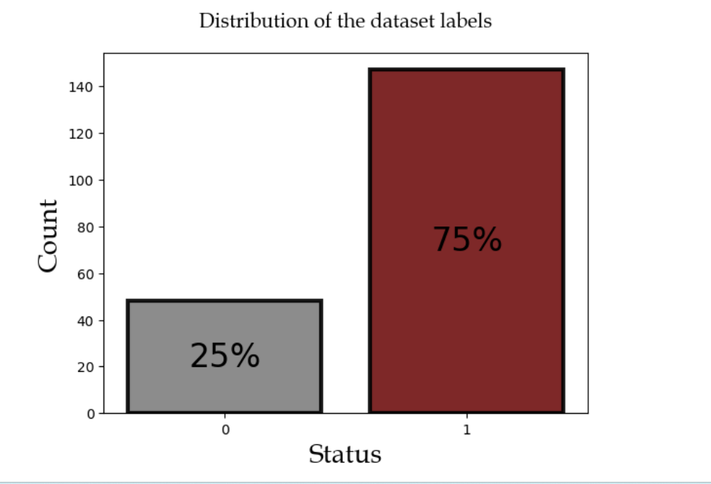
Visualization of the dataset on the basis of Healthy people & Parkinson’s disease patient.

Slide 6
Models used are:
DECISION TREE CLASSIFIER
ADA BOOSTING & GRADIENT BOOSTING
SVM
LOGISTIC
REGRESSION
RANDOM FOREST CLASSIFIER

Slide 7
Conclusion
Achieving perfect accuracy on both sets can sometimes be a sign of overfitting, where the model has simply memorized the training data and may not generalize well to new, unseen data. In contrast, a model with high accuracy on the training set but slightly lower accuracy on the testing set may indicate better generalization to new data. This is because the model has learned to identify patterns in the training data that are also present in the testing data, rather than simply memorizing the training set.
Based on our analysis and evaluation, we recommend using the ADA Boosting model over the other models for this particular problem

Slide 8
Reference:
Kaggle dataset: https://www.kaggle.com/datasets/vikasukani/parkinsons-disease-data-set/download?datasetVersionNumber=1
The coding part I have done for all mentioned models, you will find it on my Kaggle & Github link.
Kaggle link :- https://www.kaggle.com/priyanshishah24
Github link :- https://github.com/Priyanshishah24

Slide 9
THANK YOU

